Slide 1


We are a Rights Respecting School!

Slide 2

Ask your children about their rights and why they are important.

Slide 3
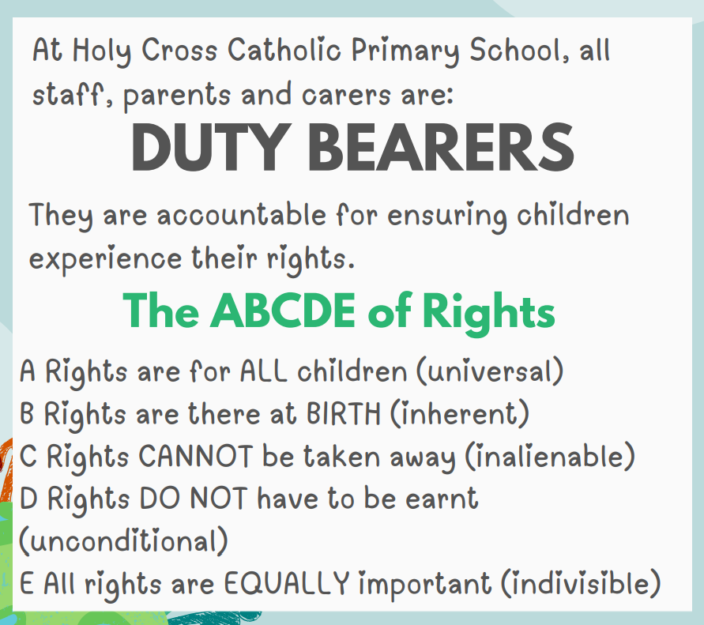

Slide 4

Article 12-Child participation
Children have important roles in school, which play a significant part in improving and upholding the rights of children.
Play leaders- setting up and arranging games for the KS1 children.
House Captains- lead their house throughout the year, roles and responsibilities in our assemblies.
Eco warriors- lead our school in being more sustainable.
Mini-vinnies- Choose and lead charity projects across the school and serve the community.
Each class has different job roles to ensure the day to day running of the class runs smoothly.
Reading warriors
Mental Health Ambassadors
Digital leaders
Catholic Life Evaluation led by the children.

Slide 5
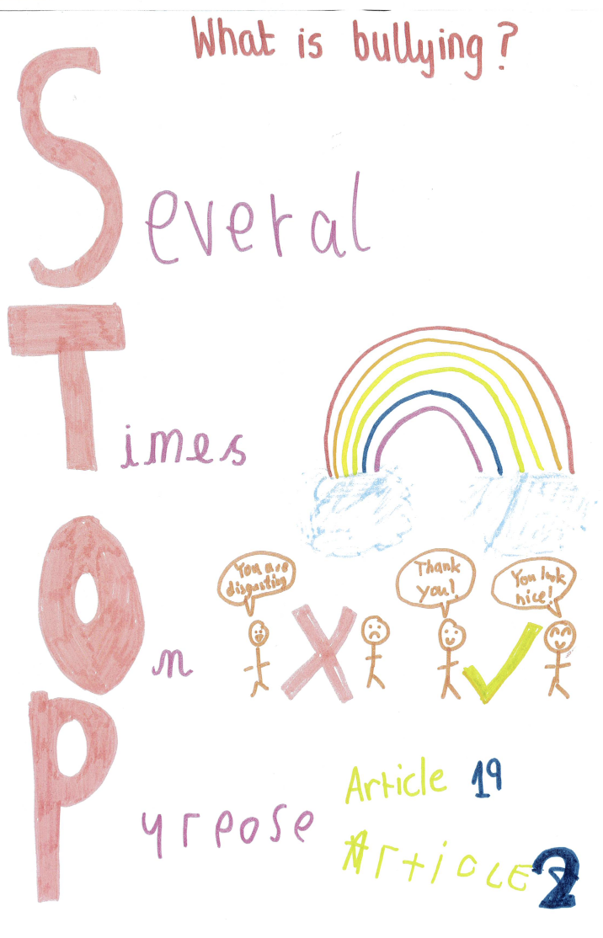
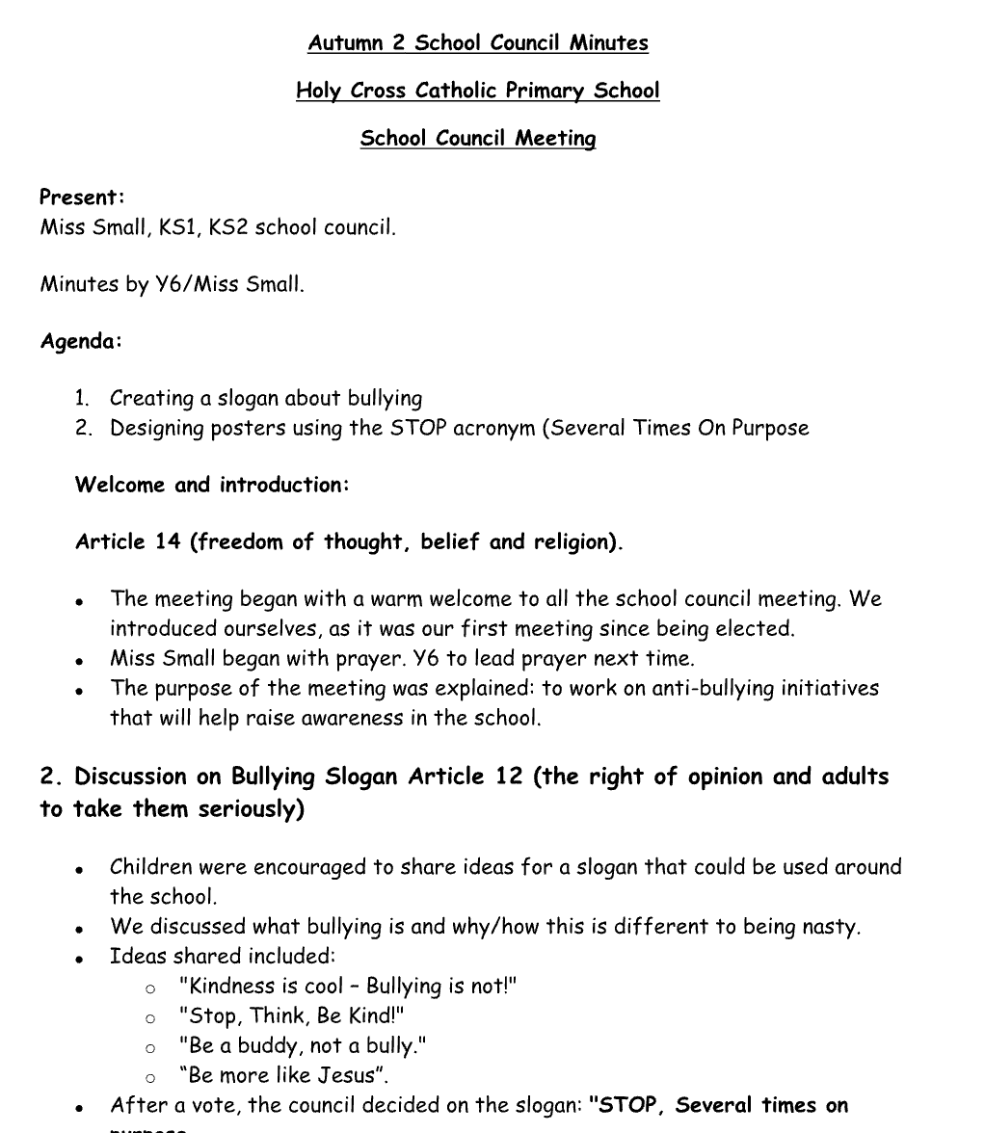
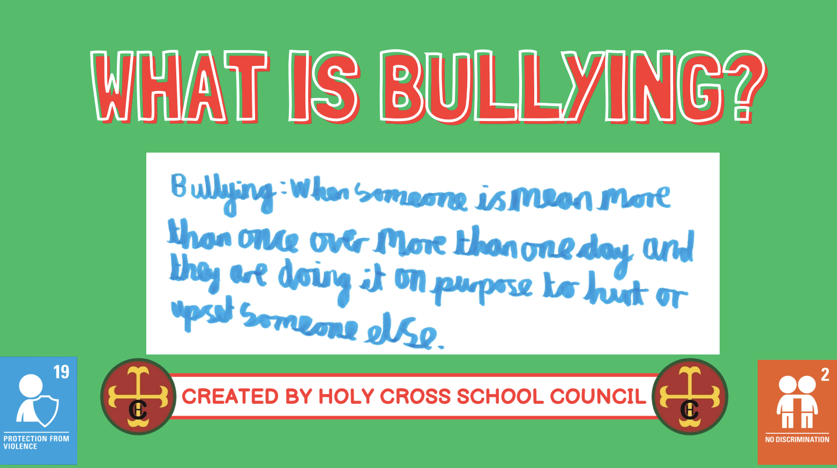
What our school council do?
As part of our safeguarding audit, pupil voice was gathered to ensure children’s views were heard. Pupils spoke confidently about feeling safe in school and could clearly identify trusted adults they could talk to if they had a worry or concern. Pupils are actively involved in shaping a safe and respectful school environment, and their feedback is valued and acted upon to maintain high safeguarding standards.
School council minutes

Slide 6
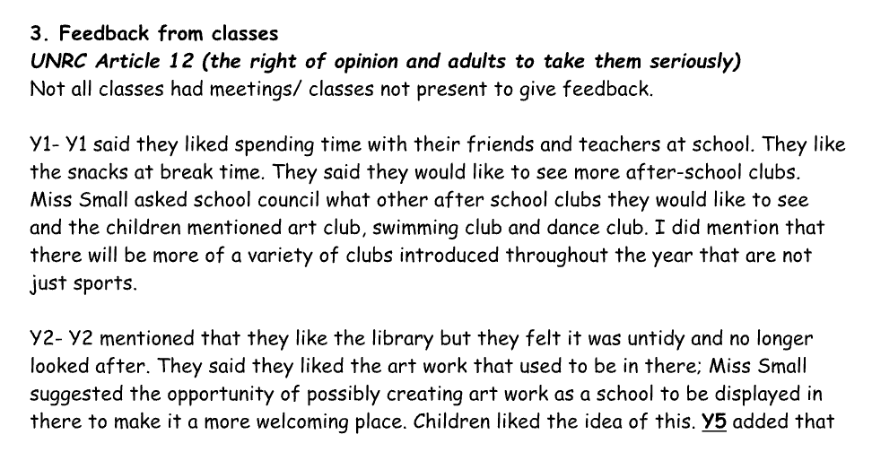
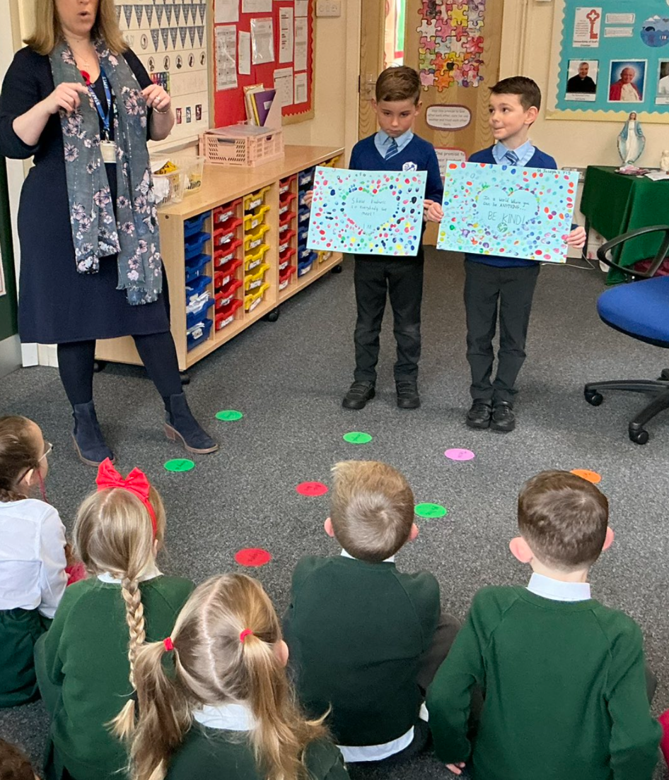
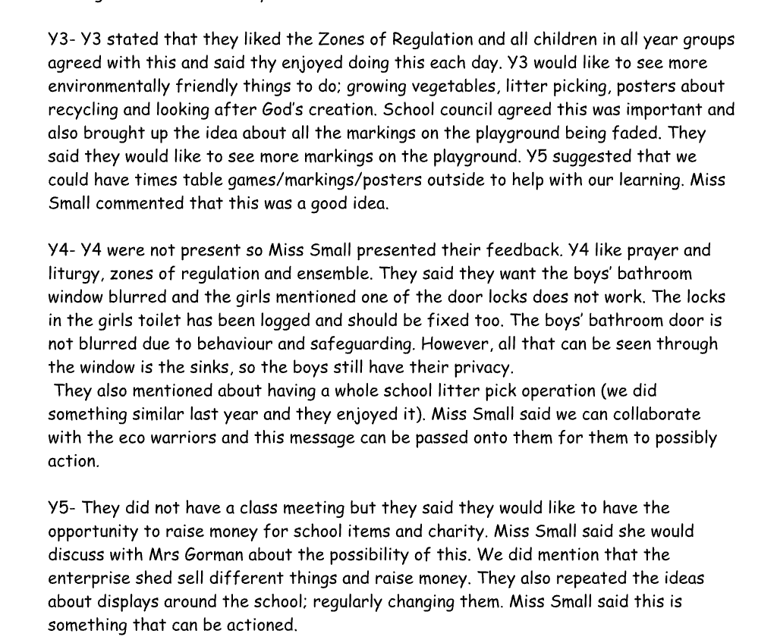
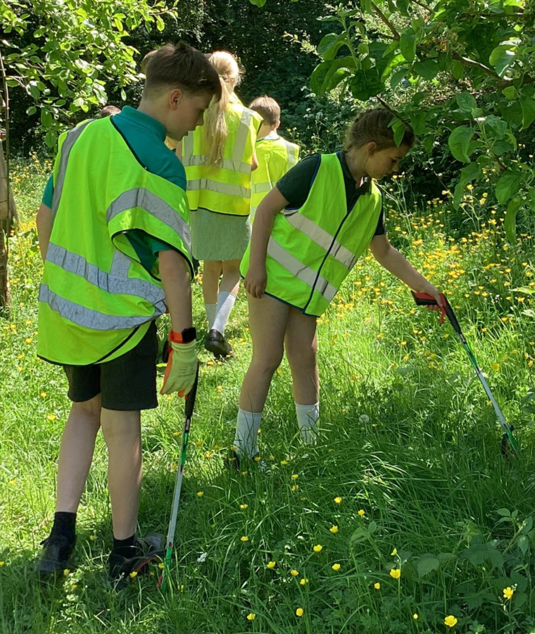
School Council Members/ Rights Respecting Team
Our school council regularly take pupil voice from their class and share this in our meetings.
Following feedback from pupils, we created ‘Reading Ambassadors’, who were responsible for promoting children to care for and look after the library.
We also joined with another school in our MAC and created art based on Kindness/Anti-Bullying week, this was showcased across the two schools.
Feedback regarding the environment was passed onto the Eco Warriors, who led a litter pick and gave each class small challenges to look after the environment. For example, making sure lights were turned off.
School council minutes where they fed back on the pupil voice.

Slide 7
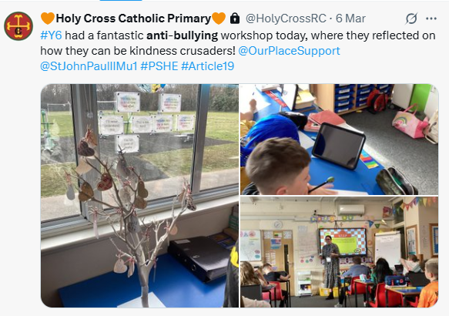

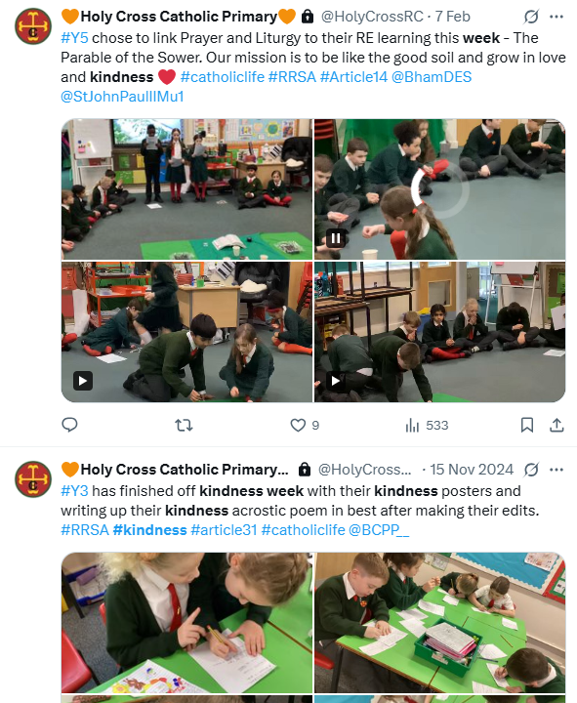
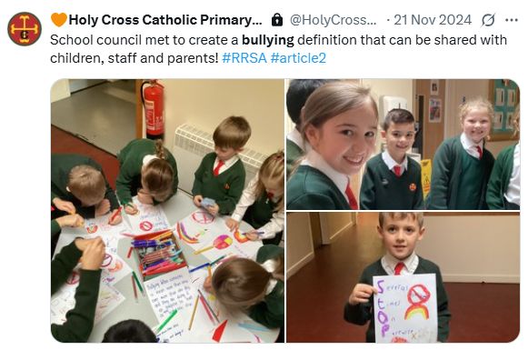
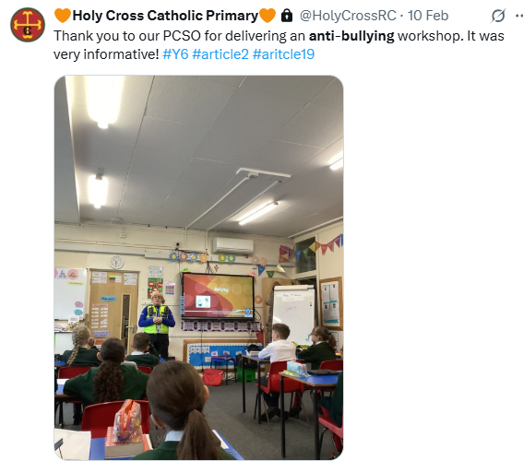
A right to be safe…
Pupils are regularly reminded of the many ways that they can access any help and support they may need. Photographs of the DSLs are displayed at the front of the school.
-Anti-bullying week
PCSO
Kindness week
STOP campaign school council
Speak out stay safe
No pants rule

Slide 8
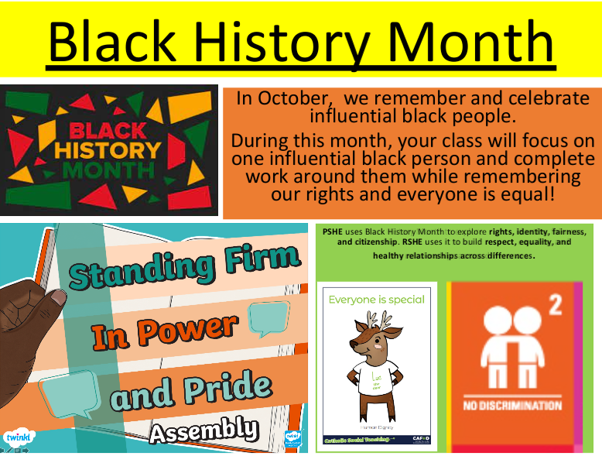
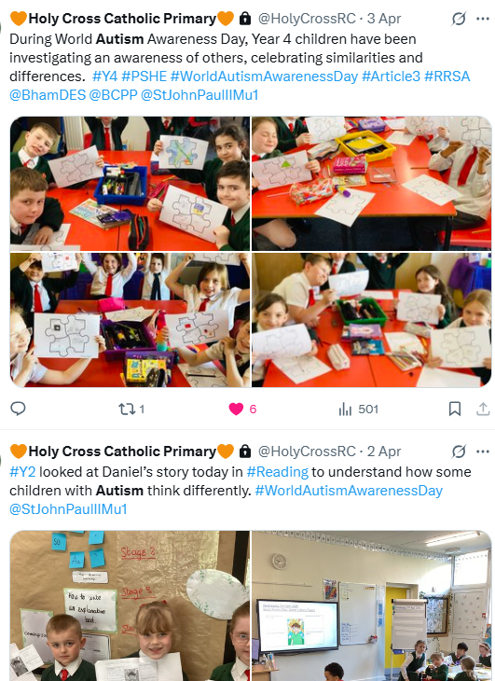

Diversity and Inclusion
Through our learning and discussions, we understand why inclusion is important and value everyone’s differences, while also recognising that in the past not all people were treated fairly or included, and we work together to make sure that doesn’t happen in our school.
During Autism Awareness Week, we learn that equality means everyone has the same rights and should be treated fairly, but equity means giving people the support they need so they can enjoy those rights equally.
Every year, we celebrate World Autism Day. The children learn about Autism and celebrate what makes us all different.

Slide 9

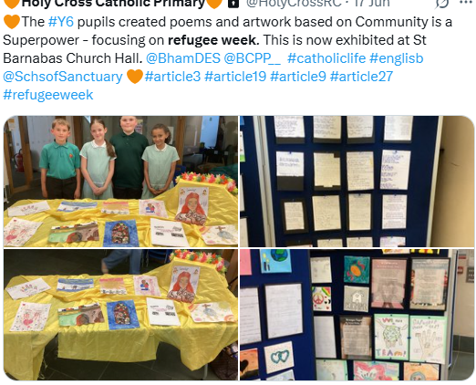
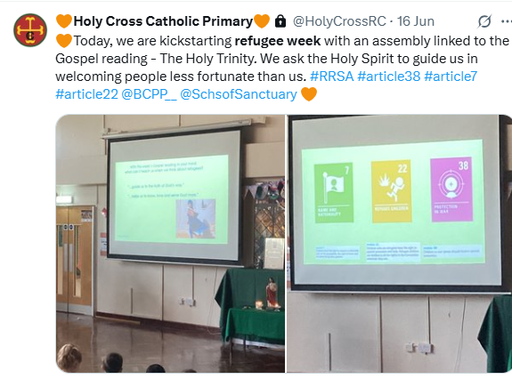
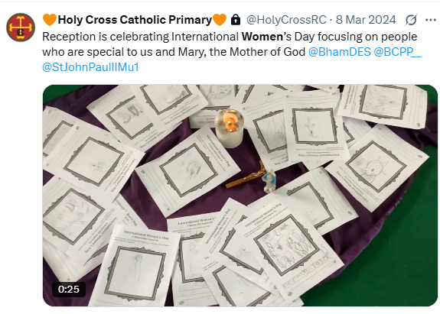
Every child has the right to feel they belong…
Through our learning and discussions, we understand why inclusion is important and value everyone’s differences, while also recognising that in the past not all people were treated fairly or included, and we work together to make sure that doesn’t happen in our school.

Slide 10
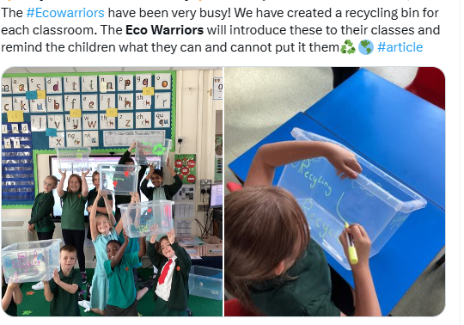
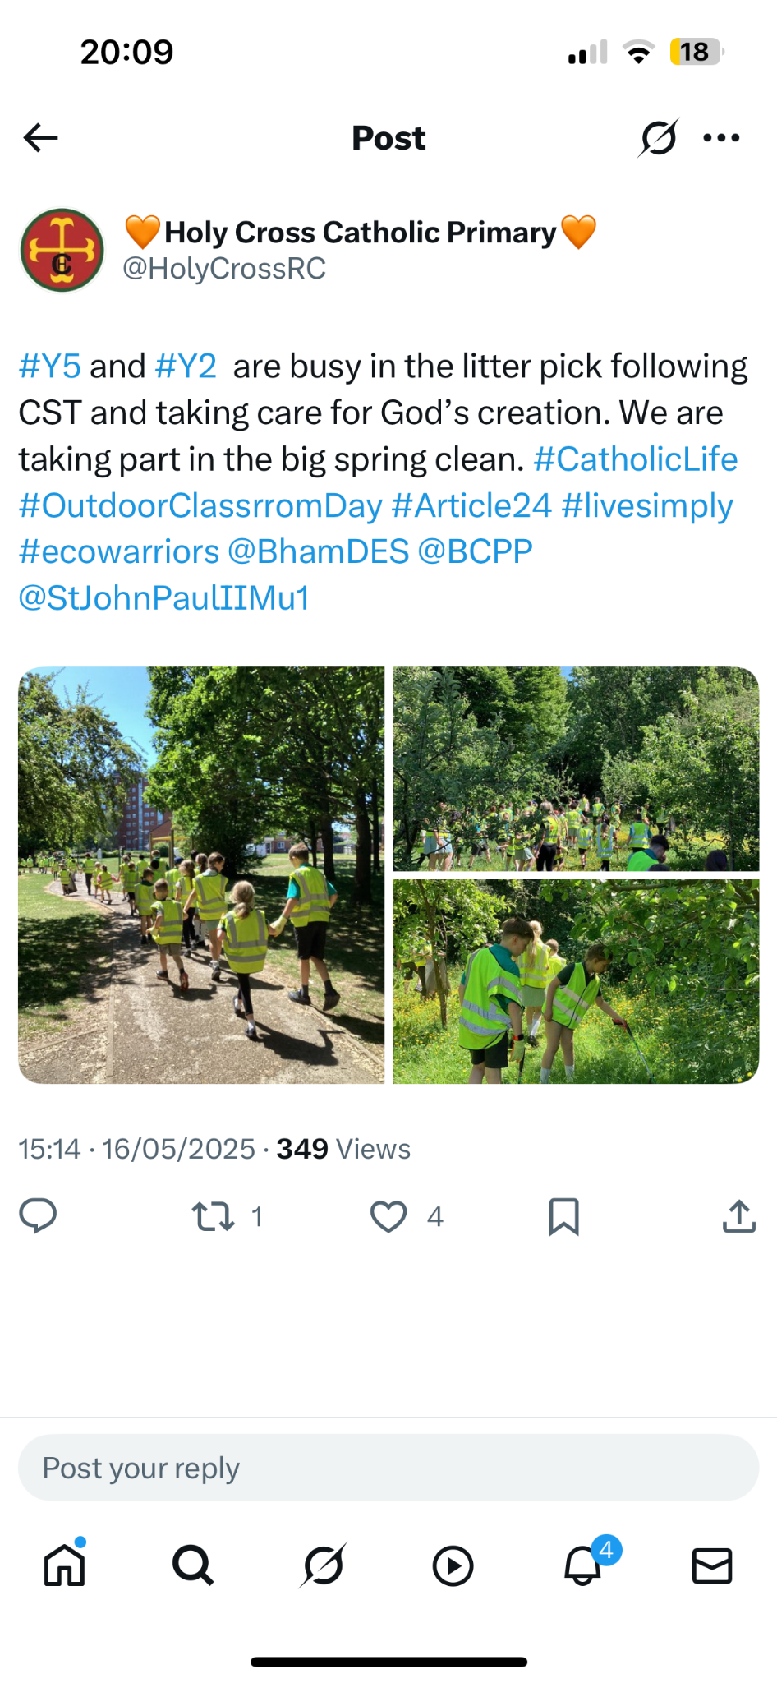

A right to a clean and safe environment.
Our Eco Warriors led the school in taking climate action.

Slide 11
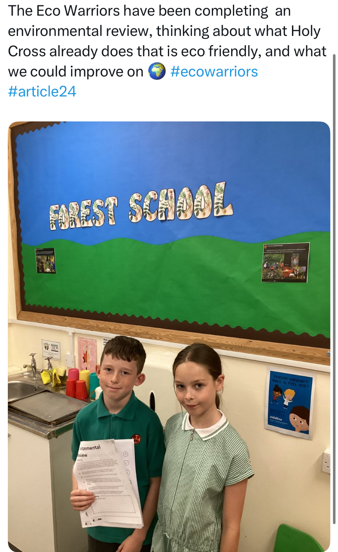
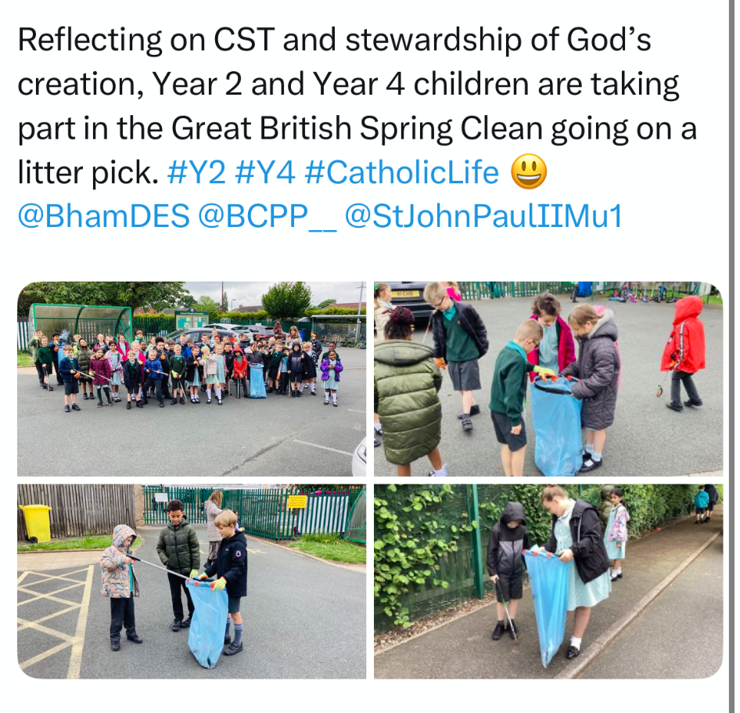
A right to a clean and safe environment.
Our Eco Warriors led the school in taking climate action.

Slide 12
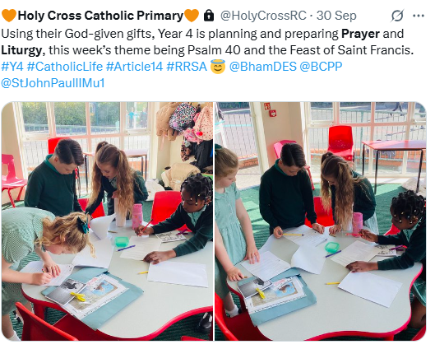
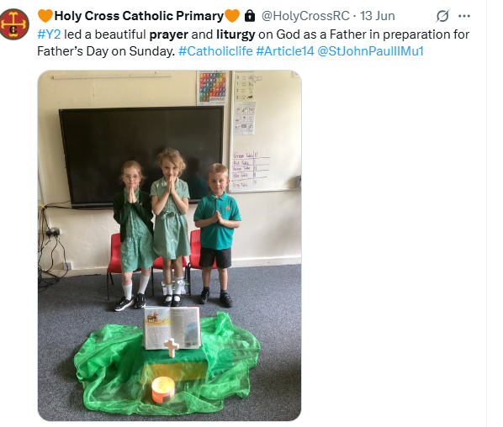
Child-led learning
Each week, the children lead their own prayer and liturgy. They plan it during the week and lead it during Friday afternoon. They also evaluate it.

Slide 13
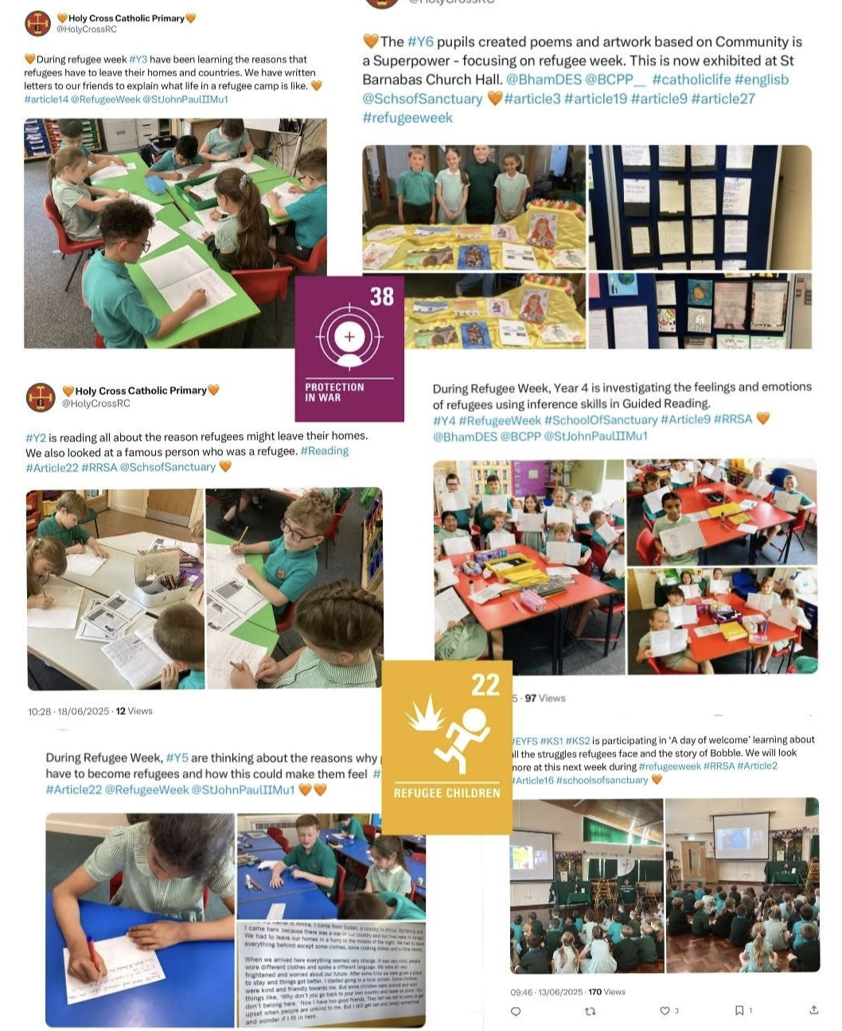

Dignity and respect
Learning about Refugee Week helps us understand that everyone, regardless of their background or circumstances, has the right to live with dignity. We explore the experiences and challenges faced by refugees, which encourages empathy and breaks down stereotypes.
By hearing real stories, discussing global issues, and celebrating the strengths and contributions of refugees, we learn to value diversity and treat others with fairness and respect.

Slide 14
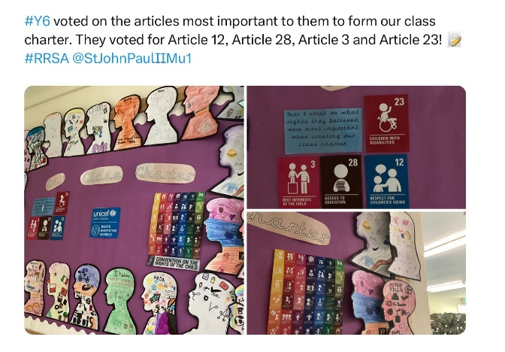
We all made class charters and voted on the most important rights to us…

Slide 15
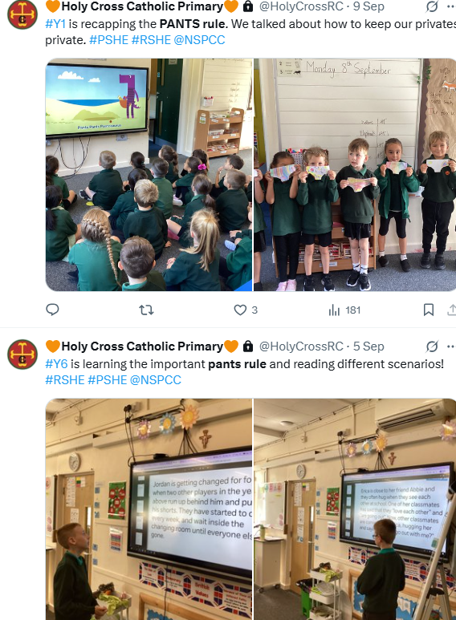
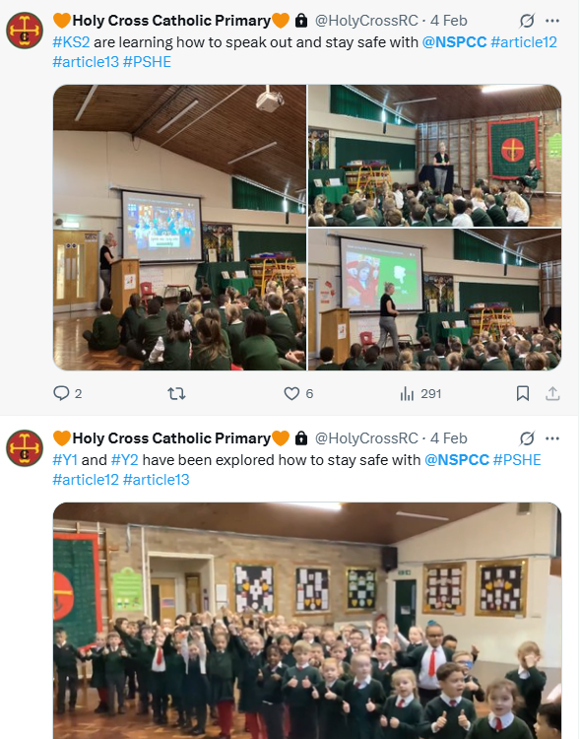
To right to be safe and heard…
Children learn how to keep themselves safe; PANTS rules, speak out and stay safe with NSPCC.

Slide 16
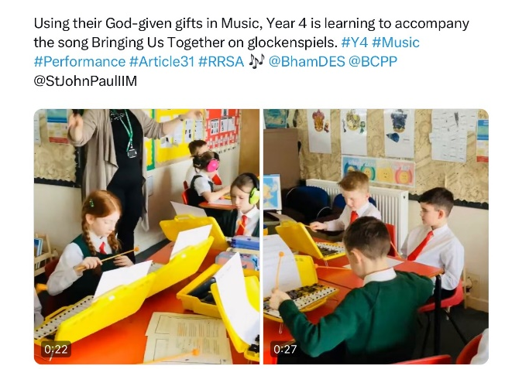

Article 31- We all have the right to play, participate in arts and leisure…

Slide 17
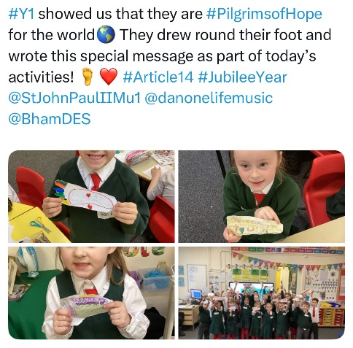

Article 14- We all have the right to freedom of thought and religion…

Slide 18
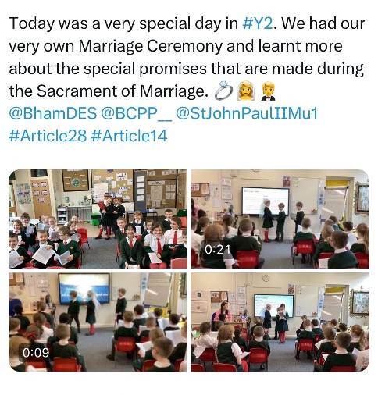
Article 14- We all have the right to freedom of thought and religion…

Slide 19

Ask us about all the other rights…

Slide 20

Ask us about the October Spotlight Articles!

